Slide 1
Introduction
J2EE Web Development using JSP & Servlets
Notes:
20778C
1: Introduction to Self-Service BI Solutions

Slide 2
Your Instructor
LENG Chee Kong
ckleng1964@gmail.com
0192133329

Slide 3
Training Schedule
Duration: 5 Days Training Hours: 9am~5pm Lunch Break:
Monday ~ Thursday: 12:30pm~1:30pm (1 Hour)
Friday: 12:30pm~2:30pm (2 Hours)
Short Breaks:
Morning: 10:30am~10:45am
Afternoon: 3:30pm~3:45pm
Notes:
20778C
1: Introduction to Self-Service BI Solutions

Slide 4
Course Supporting Website
JavaCourses.azurewebsites.net
Notes:
20778C
1: Introduction to Self-Service BI Solutions

Slide 5
Software Installation
JDK 11
Apache NetBeans 18 with JEE support
MySQL

Slide 6
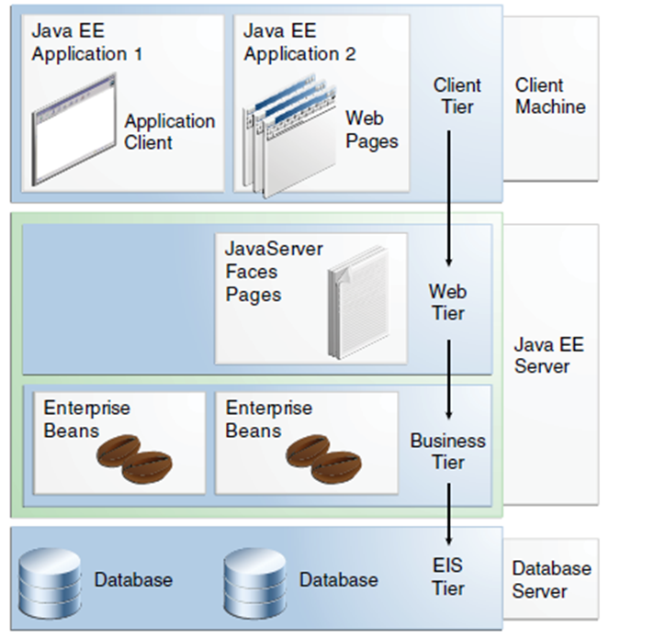
Multitiered Applications

Slide 7
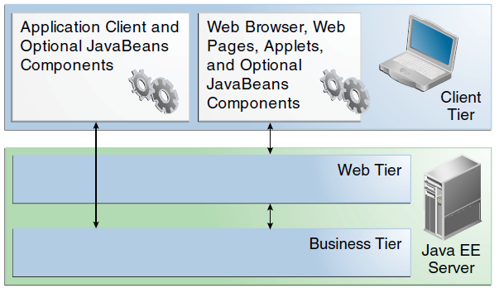
Server Communication

Slide 8
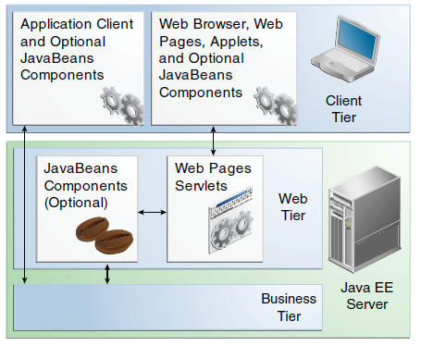
Web Tier and Java EE Applications

Slide 9
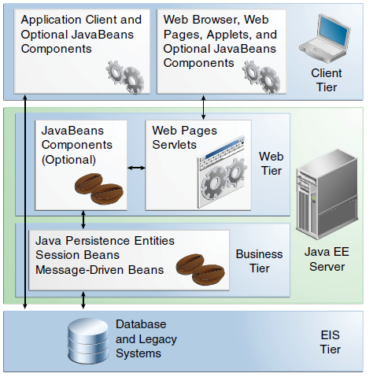
Business and EIS Tiers

Slide 10
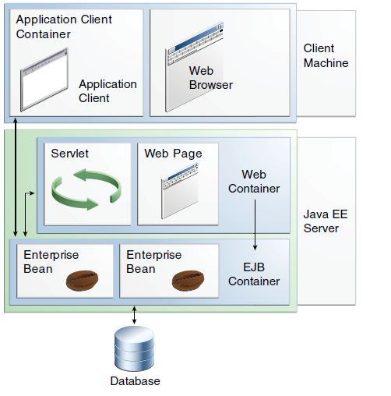
Java EE Server and Containers

Slide 11
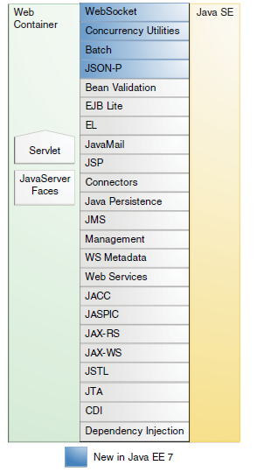
Java EE APIs in the Web Container

Slide 12
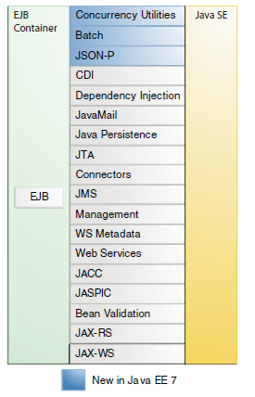
Java EE APIs in the EJB Container

Slide 13
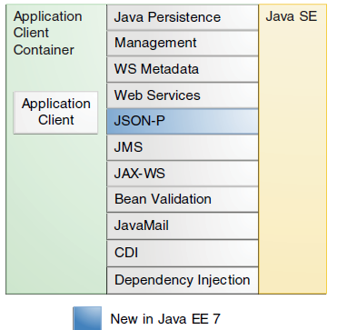
Java EE APIs in the Application Client Container

Slide 14
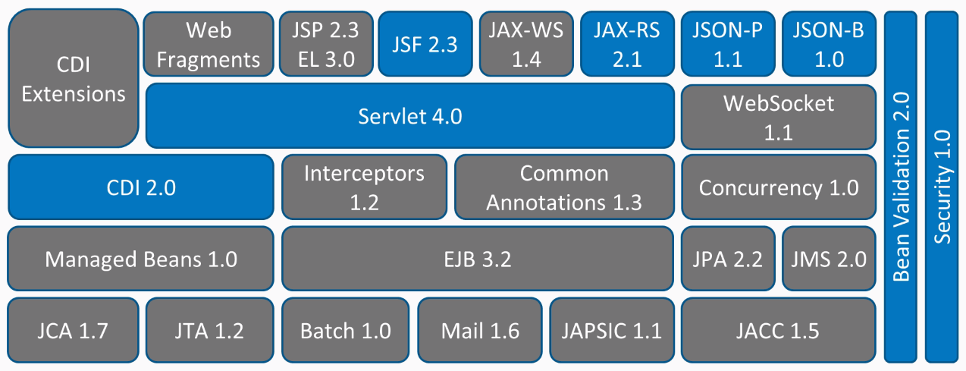
Overview of Java EE 8

Slide 15
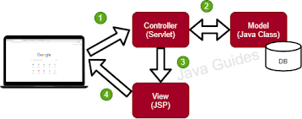
MVC

