Slide 1
Multithreading

Slide 2
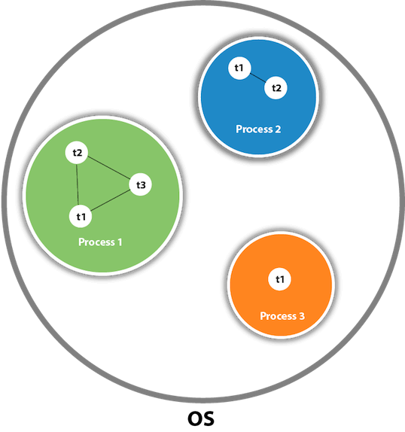
Intro
A thread is a lightweight subprocess, the smallest unit of processing. It is a separate path of execution.
Threads are independent. If there occurs exception in one thread, it doesn't affect other threads. It uses a shared memory area

Slide 3
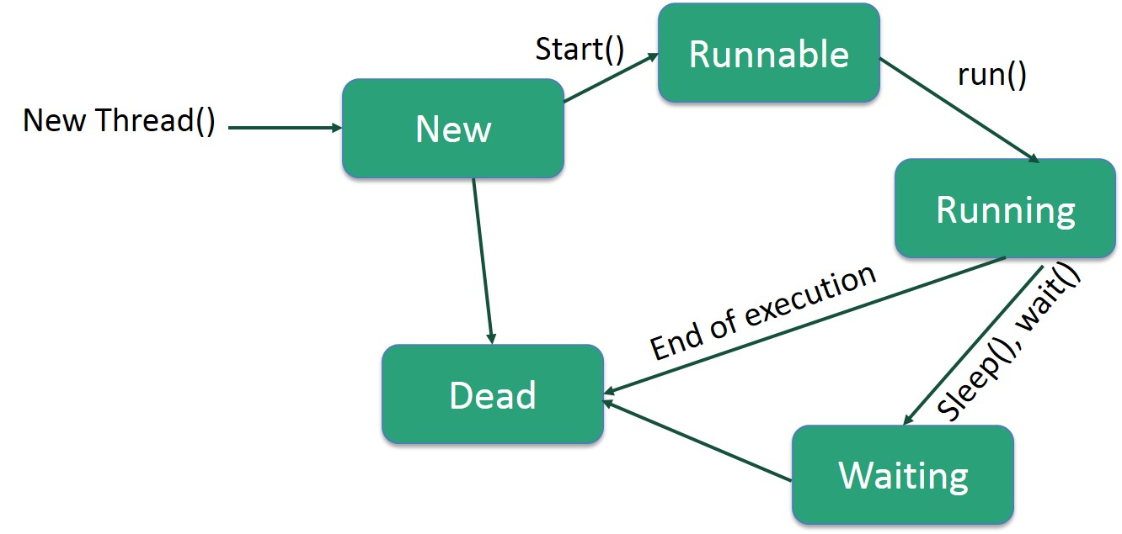
Life Cycle of a Thread

